Slide 1



COURSE MANAGEMENT
Presented By:
Poorvi 20241IST0080
Madan 20241IST0081
Srujan 20241IST0082
Charan 20241IST0083

Slide 2



Introduction
The Course Management Website is designed to organize, deliver, and track academic courses for both instructors and students.

Slide 3

Objectives
    Centralized e-learning management
    Improved transparency
    Enhanced collaboration
    Blended learning support

Slide 4
Overview
A Course Management System (CMS) allows faculty to upload course content, and students to access and submit work online.

Slide 5
Key Features(The pages)
1
2
3
4
5
Faculty page
Student page
Lecture Uploads
View page for students
Assignment Submission
Grading System
Progress Tracking

Slide 6

Allocate resources
Determine the types and quantities of resources needed for each project task, including personnel, equipment, materials, and facilities.

Slide 7
User Roles
NAME | ROLE
FACULTY | Upload Materials, create quizzes, evaluate students
STUDENTS | Access Materials, Submit assignments, view progress

Slide 8

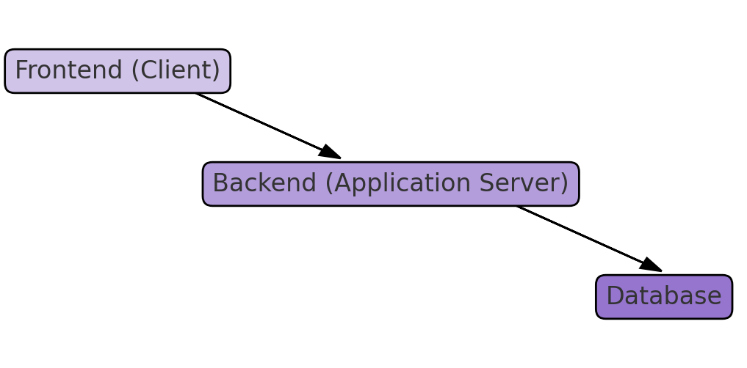
System Architecture

Slide 9

Benefits
• Simplifies course management
• Enhances digital learning
• Improves communication
• Transparent evaluation

Slide 10

Challenges
→ Internal Dependency
→ Technical Familiarity
→ Security and Maintenance

Slide 11



Future Enhancements
AI Integration
Mobile App
Cloud storage optimization
Advanced Analytics

Slide 12

Conclusion
An integrated e-learning platform fostering efficient academic management and digital education.

